Slide 1
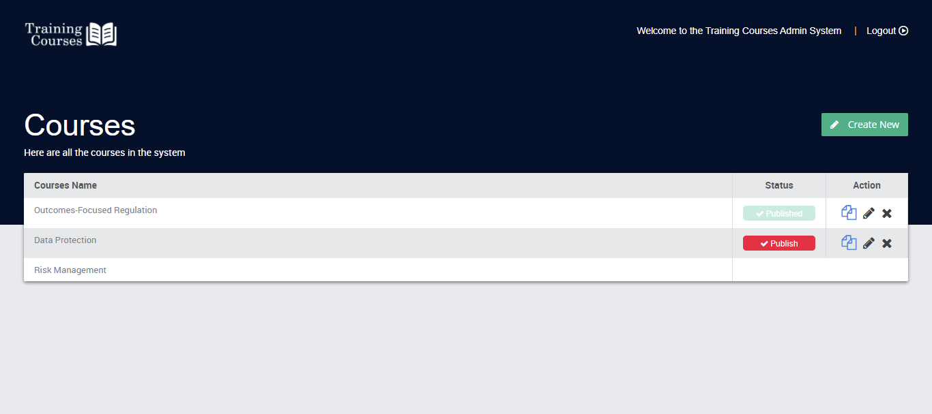
Use our library of available courses or let us embed your course content in the system
COURSES AVAILABLE ON REQUEST

Slide 2
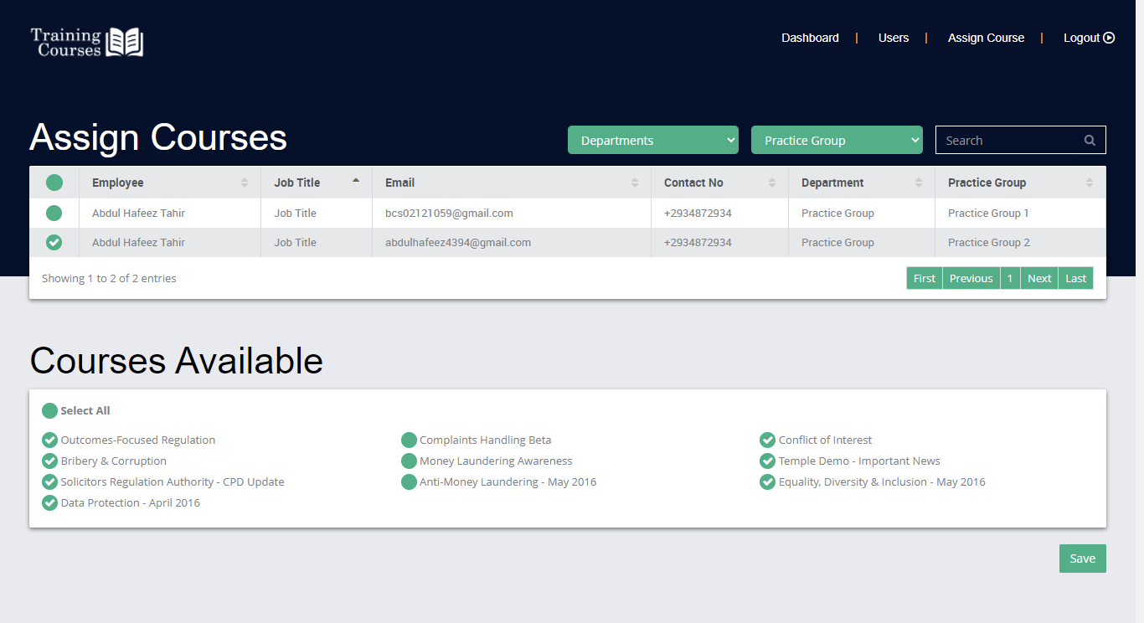
View a list of courses and assign courses to individuals or groups OF employees

Slide 3
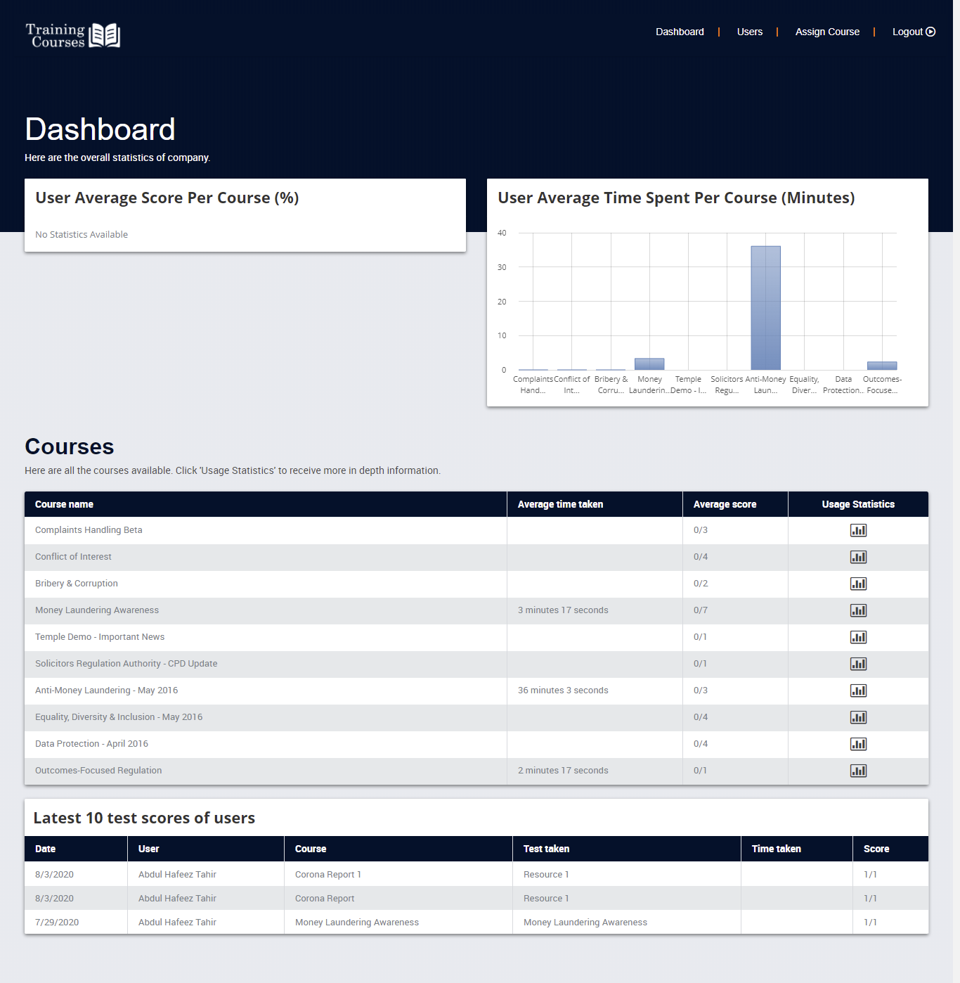
The Dashboard gives an overview of company and employEe’s performance statistics

Slide 4
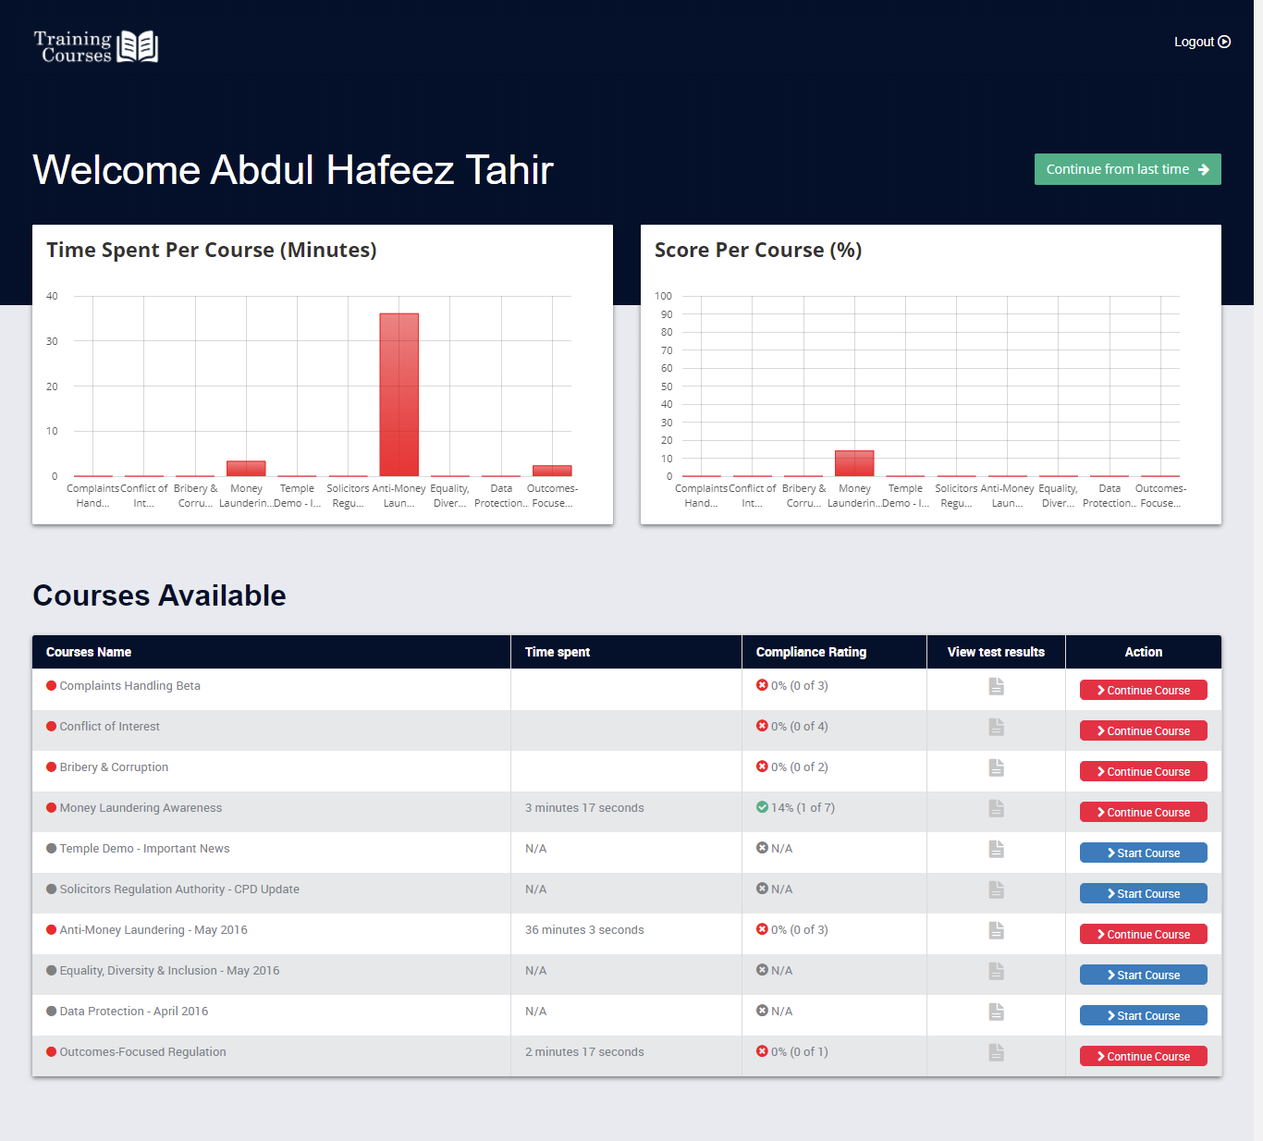
EACH Employee has complete visibility of their progress on each course

Slide 5

Course’s content is displayed in an intuitive and user-friendly manner

Slide 6
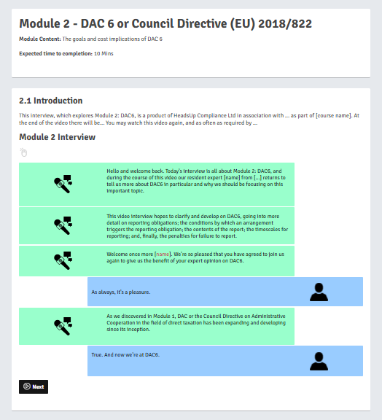
DIFFERENT WAYS OF ANSWERING QUESTIONS that increase the user’s interest and engagement
HERE IS A
DIALOGUE FOR EXAMPLE

Slide 7
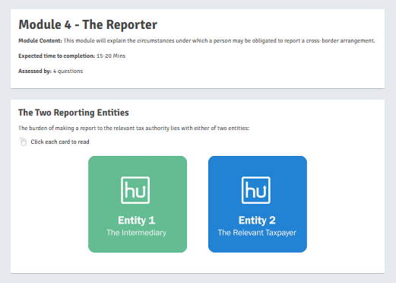
More ways to DISPLAY INFORMATION which means new ways to answer questions

Slide 8
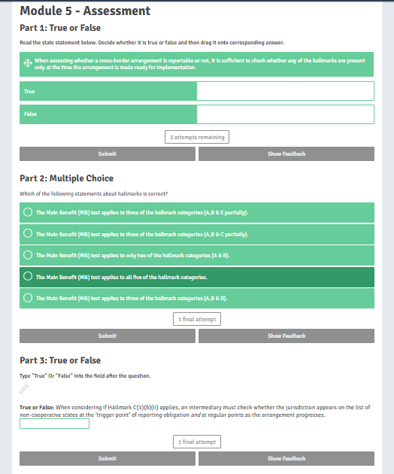
Assessments use techniques that keep user’s attention to the questions instead of repetitively ticking answers

Slide 9
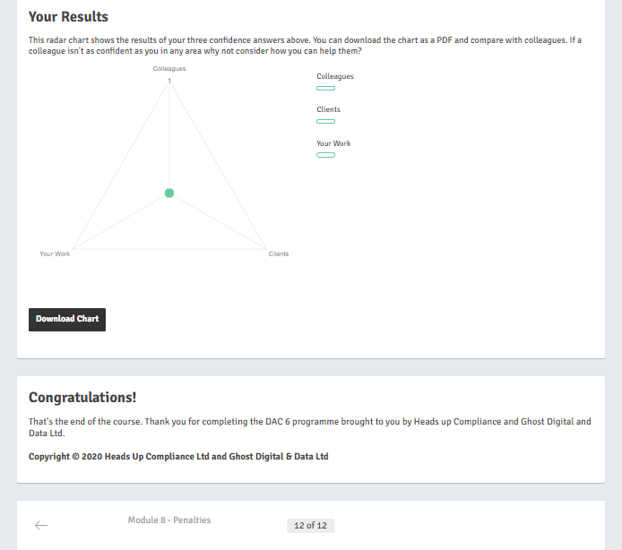
Results provide meaningful data to evaluate ability
AND score
CANDIDATE

